Slide 1
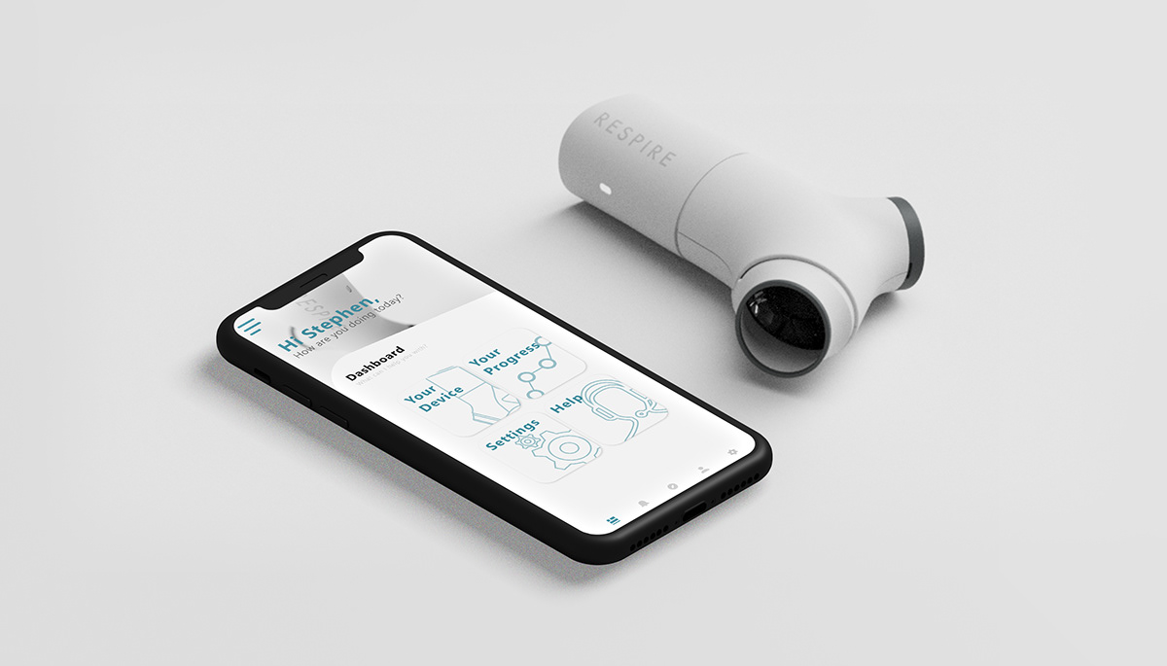
DIGIPUFF
Smart asthma inhaler
Supervisor:
Mr.Nasir Mehmood
Co-supervisor:
Dr.Rehan Ashraf

Slide 2
Group members
Asheer Butt 18-NTU-CS-1096
Ayesha Shamshad 18-NTU-CS-1084
Samra Asfand 18-NTU-CS-1071

Slide 3
Table of content
Introduction
Our purpose
Problem Statement
Objective
Tools and technology
Methodology
Requirements
Targeted audience
Sequence Diagram
Use case Diagram
Class diagram
Database Diagram
Main Goal

Slide 4
Introduction
What is DigiPuff?
Digipuff(smart inhaler) is an inhaler that connects with a mobile app via Bluetooth using Bluetooth sensor and our device has much more sensor with it like air quality sensor, GPS sensor etc.
Our Digipuff inhaler tells our mobile app that how, when and where patient use the device Our mobile application reminds the patient about his/her dosage according to the scheduled time through notifications and also through inhaler device by glowing its led and alert the patient of missing dosage.
On the other hand doctor also monitors the patient usage so that he/she gives a feedback to their patients and also predicts the attack

Slide 5
Our purpose
Our digipuff reminds the patient of dosage on scheduled time
It shows remaining puffs so that patient knows when to refill
Also alerts the missing dose
It tell patient how much dosage the patient have to take at one time
And doctors also predict attacks and pick the solution by analyzing usage of his/her patient

Slide 6
Problem statement
Many patients misuse the freedom the inhalers by ignoring the recommended treatment schedule.
Many Patients misuse the dosage quantity.
Many patients failing to stock refills before the last one is empty
Doctors also struggle to pick what might be triggering attacks

Slide 7
Objectives
Correct usage of dose
Refill stock on time
Adhere to medication
Taking dosage on time
To aware pateints of their condition
To help doctors what triggers the asthma attack

Slide 8
Tools and technologies
Flutter framework
Dart programming
Android Studio
Firebase

Slide 9
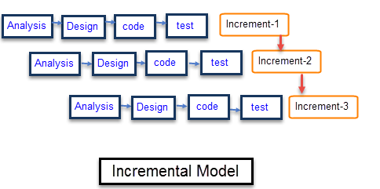
Methodology
Incremental model

Slide 10
Requirements
Functional requirements
Non-functional requirements

Slide 11
Functional requirements ( Mobile applications)
Login
Sign-up
Live usage
Live location
Dose Reminder
Missing dose alert
Remaining puffs
Recommended dosage
Feedback
Measure air quality

Slide 12
Functional requirement (inhaler device)
Sensors:
Bluetooth sensor(ESP 32)
Air quality measure sensor
GPS sensor

Slide 13
Non-functional requirements
Performance
Usability
Reliability
Security
Availability
Maintainance

Slide 14
Targeted audience
Our app is mostly for patients to monitor their real time usage and use inhaler in proper way
On the other hand our user is doctors who can use our app to interact with their patients and to get aware of their conditions.

Slide 15
Main goal
The main goal is to enable patients to maximise the effects of their prescribed medications to manage their asthma and avoid negative outcomes.

Slide 16
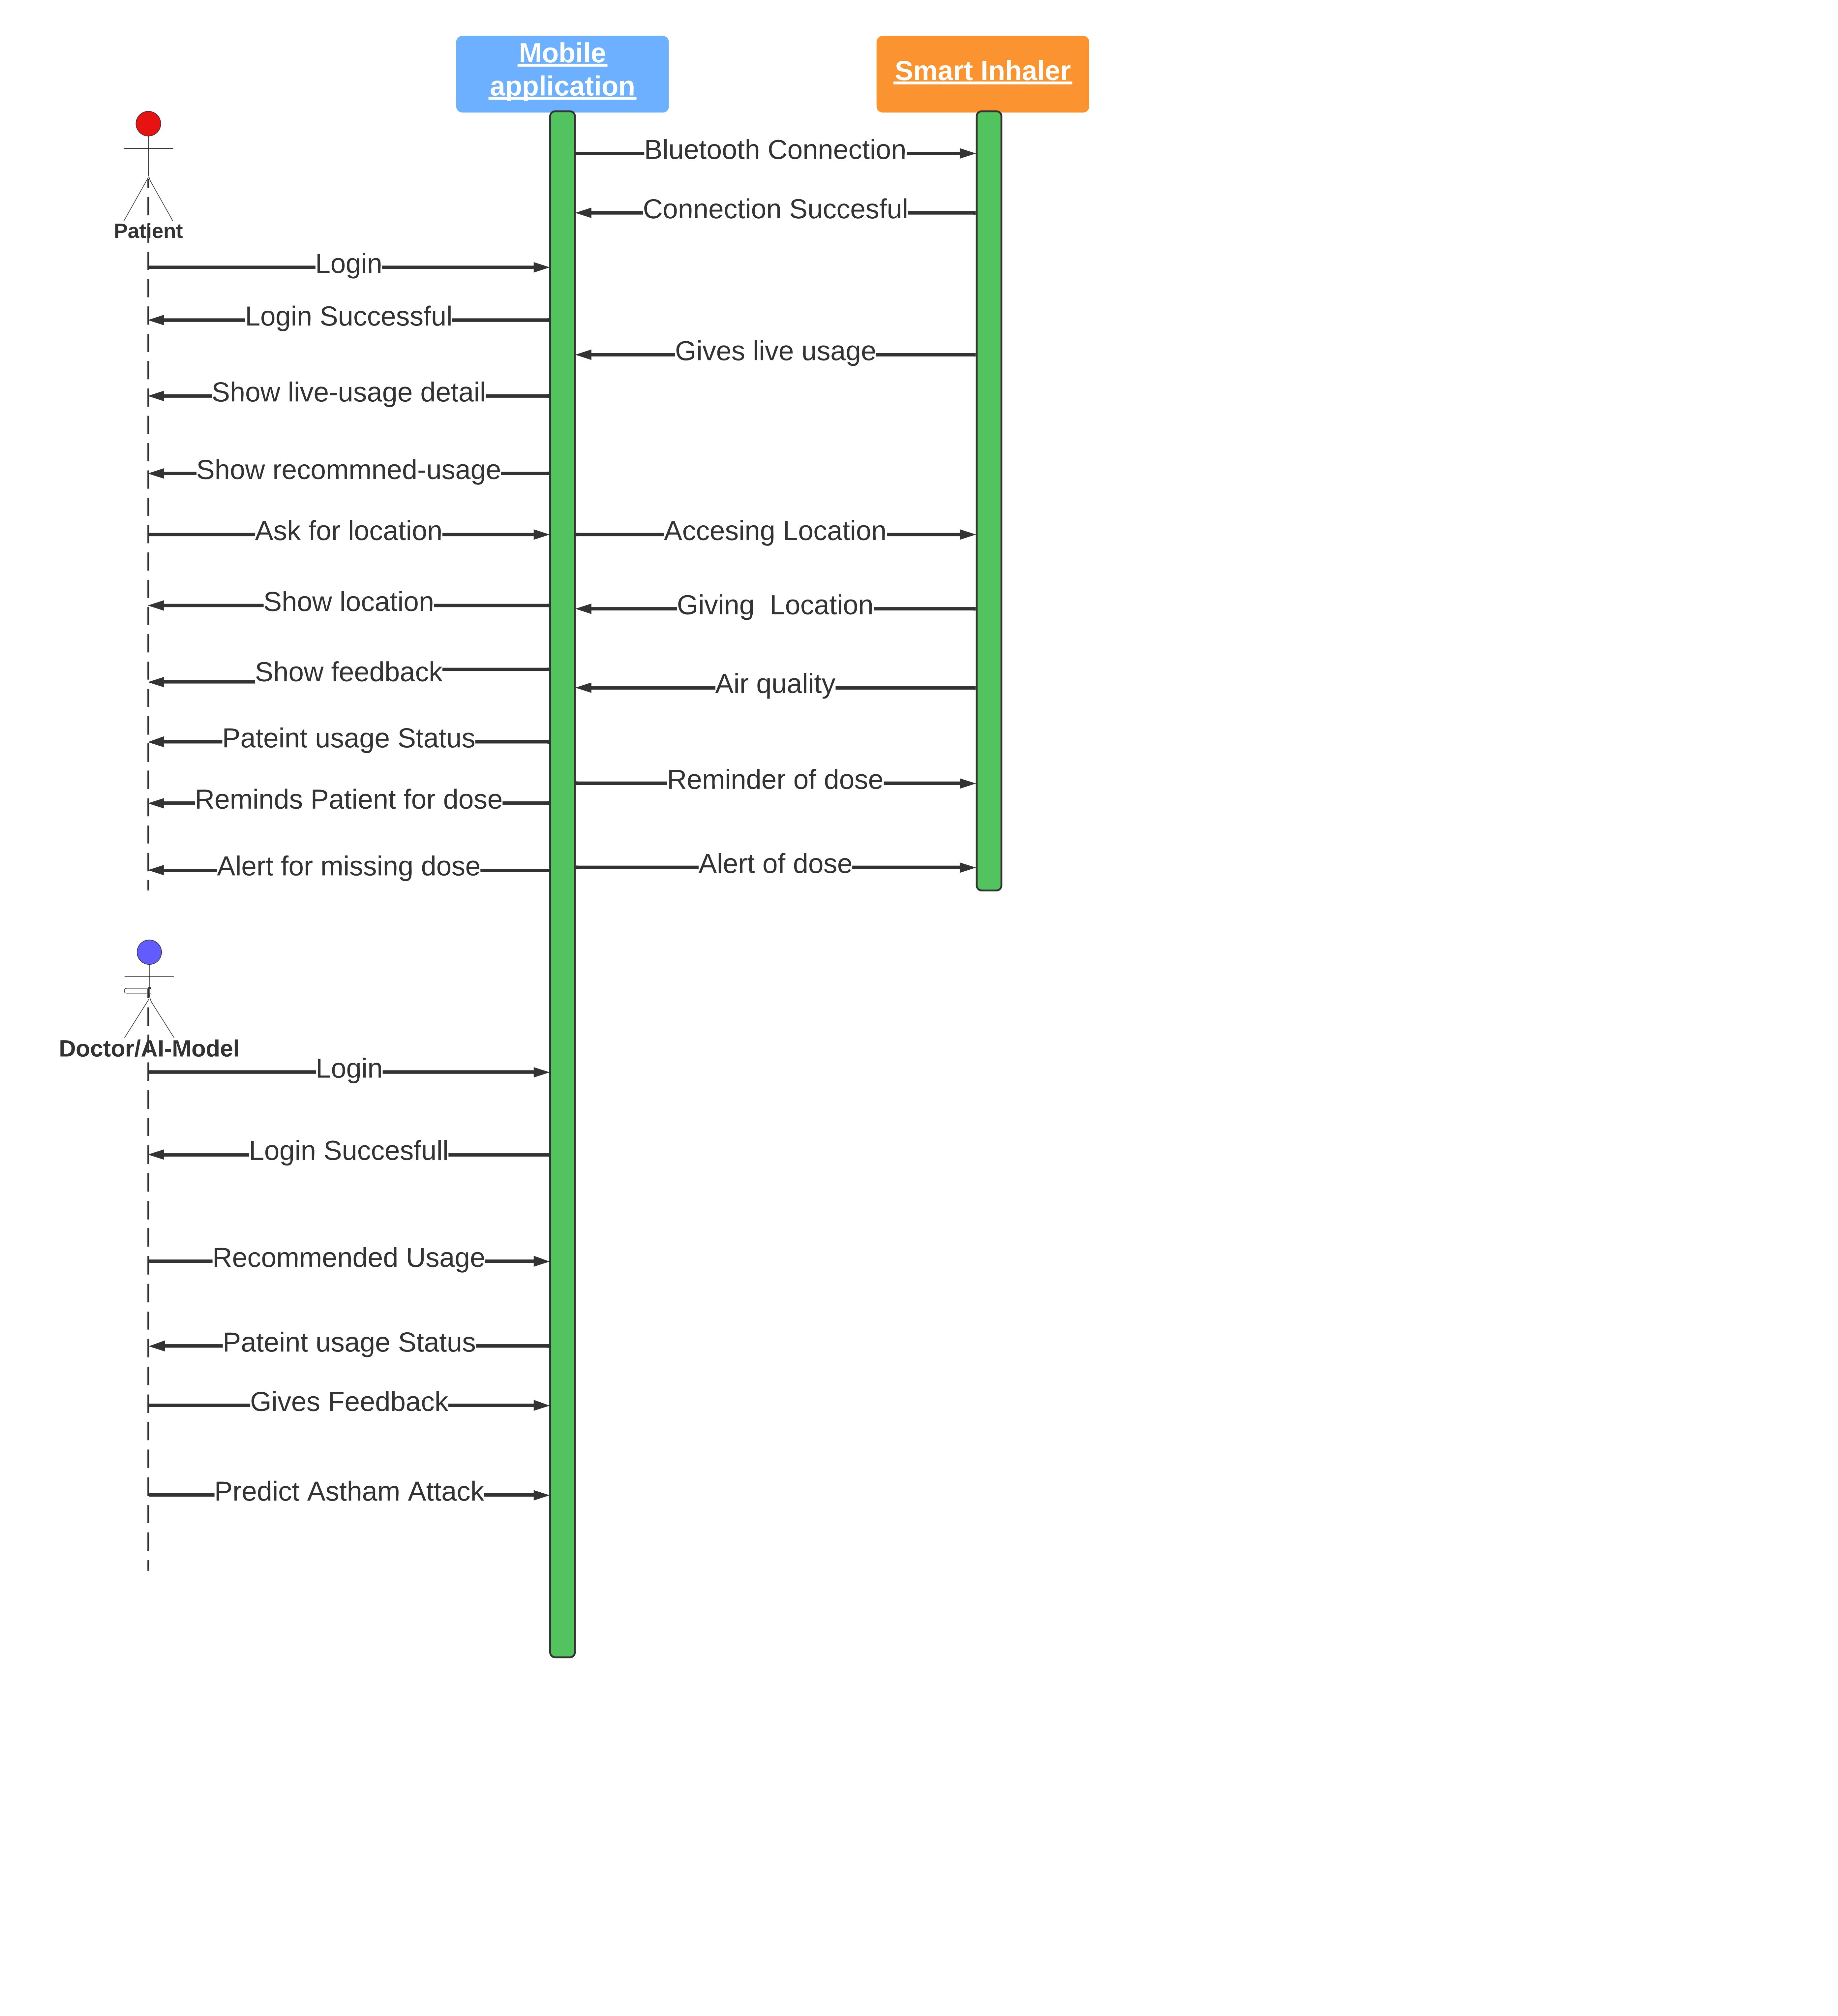
Sequence diagram

Slide 17
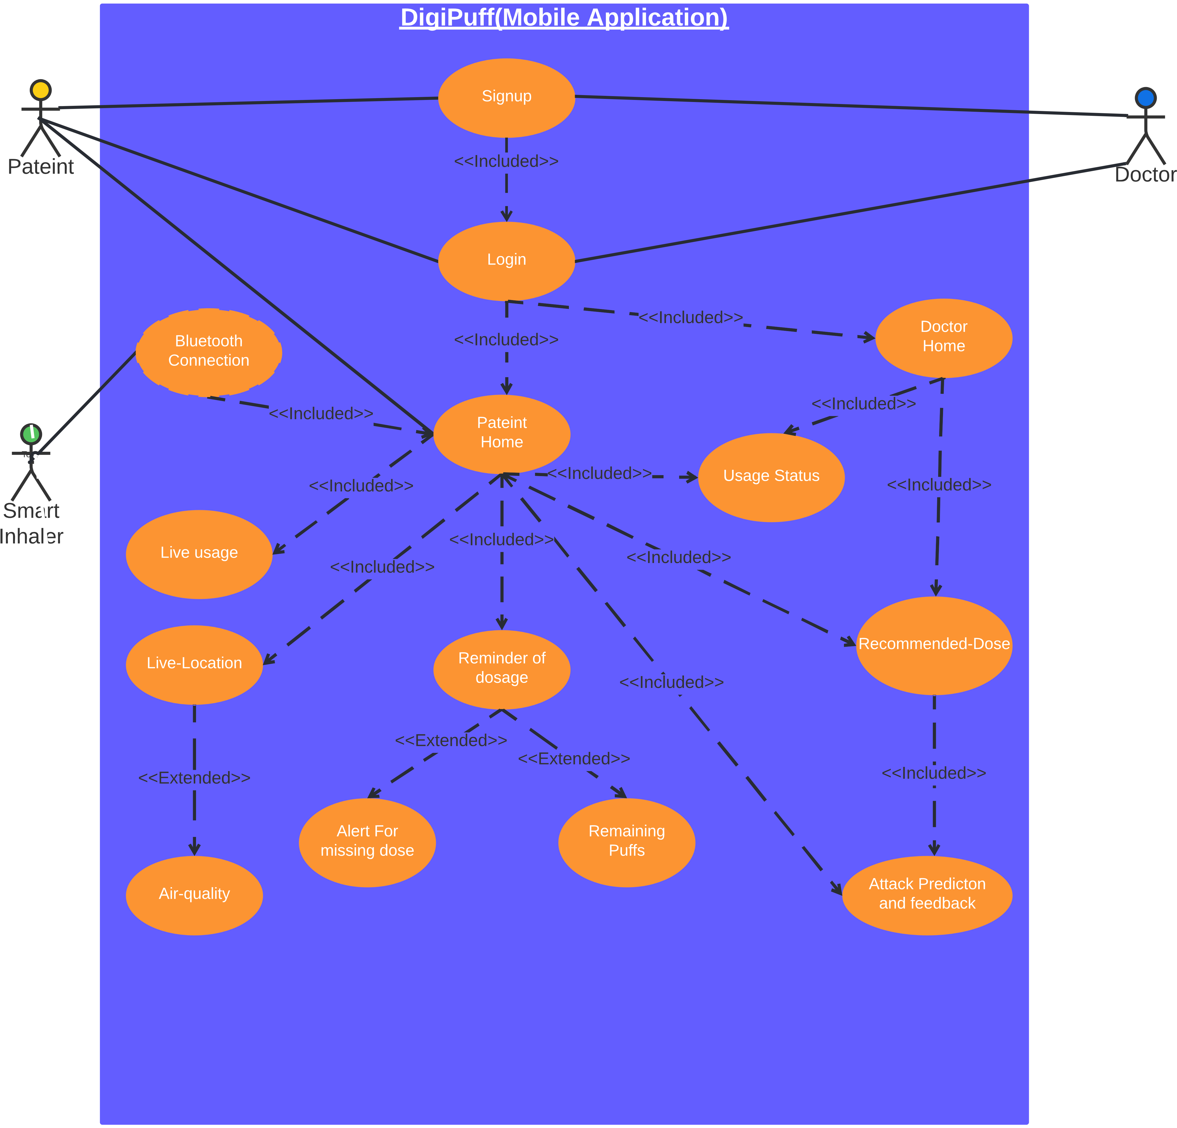
Use case diagram

Slide 18
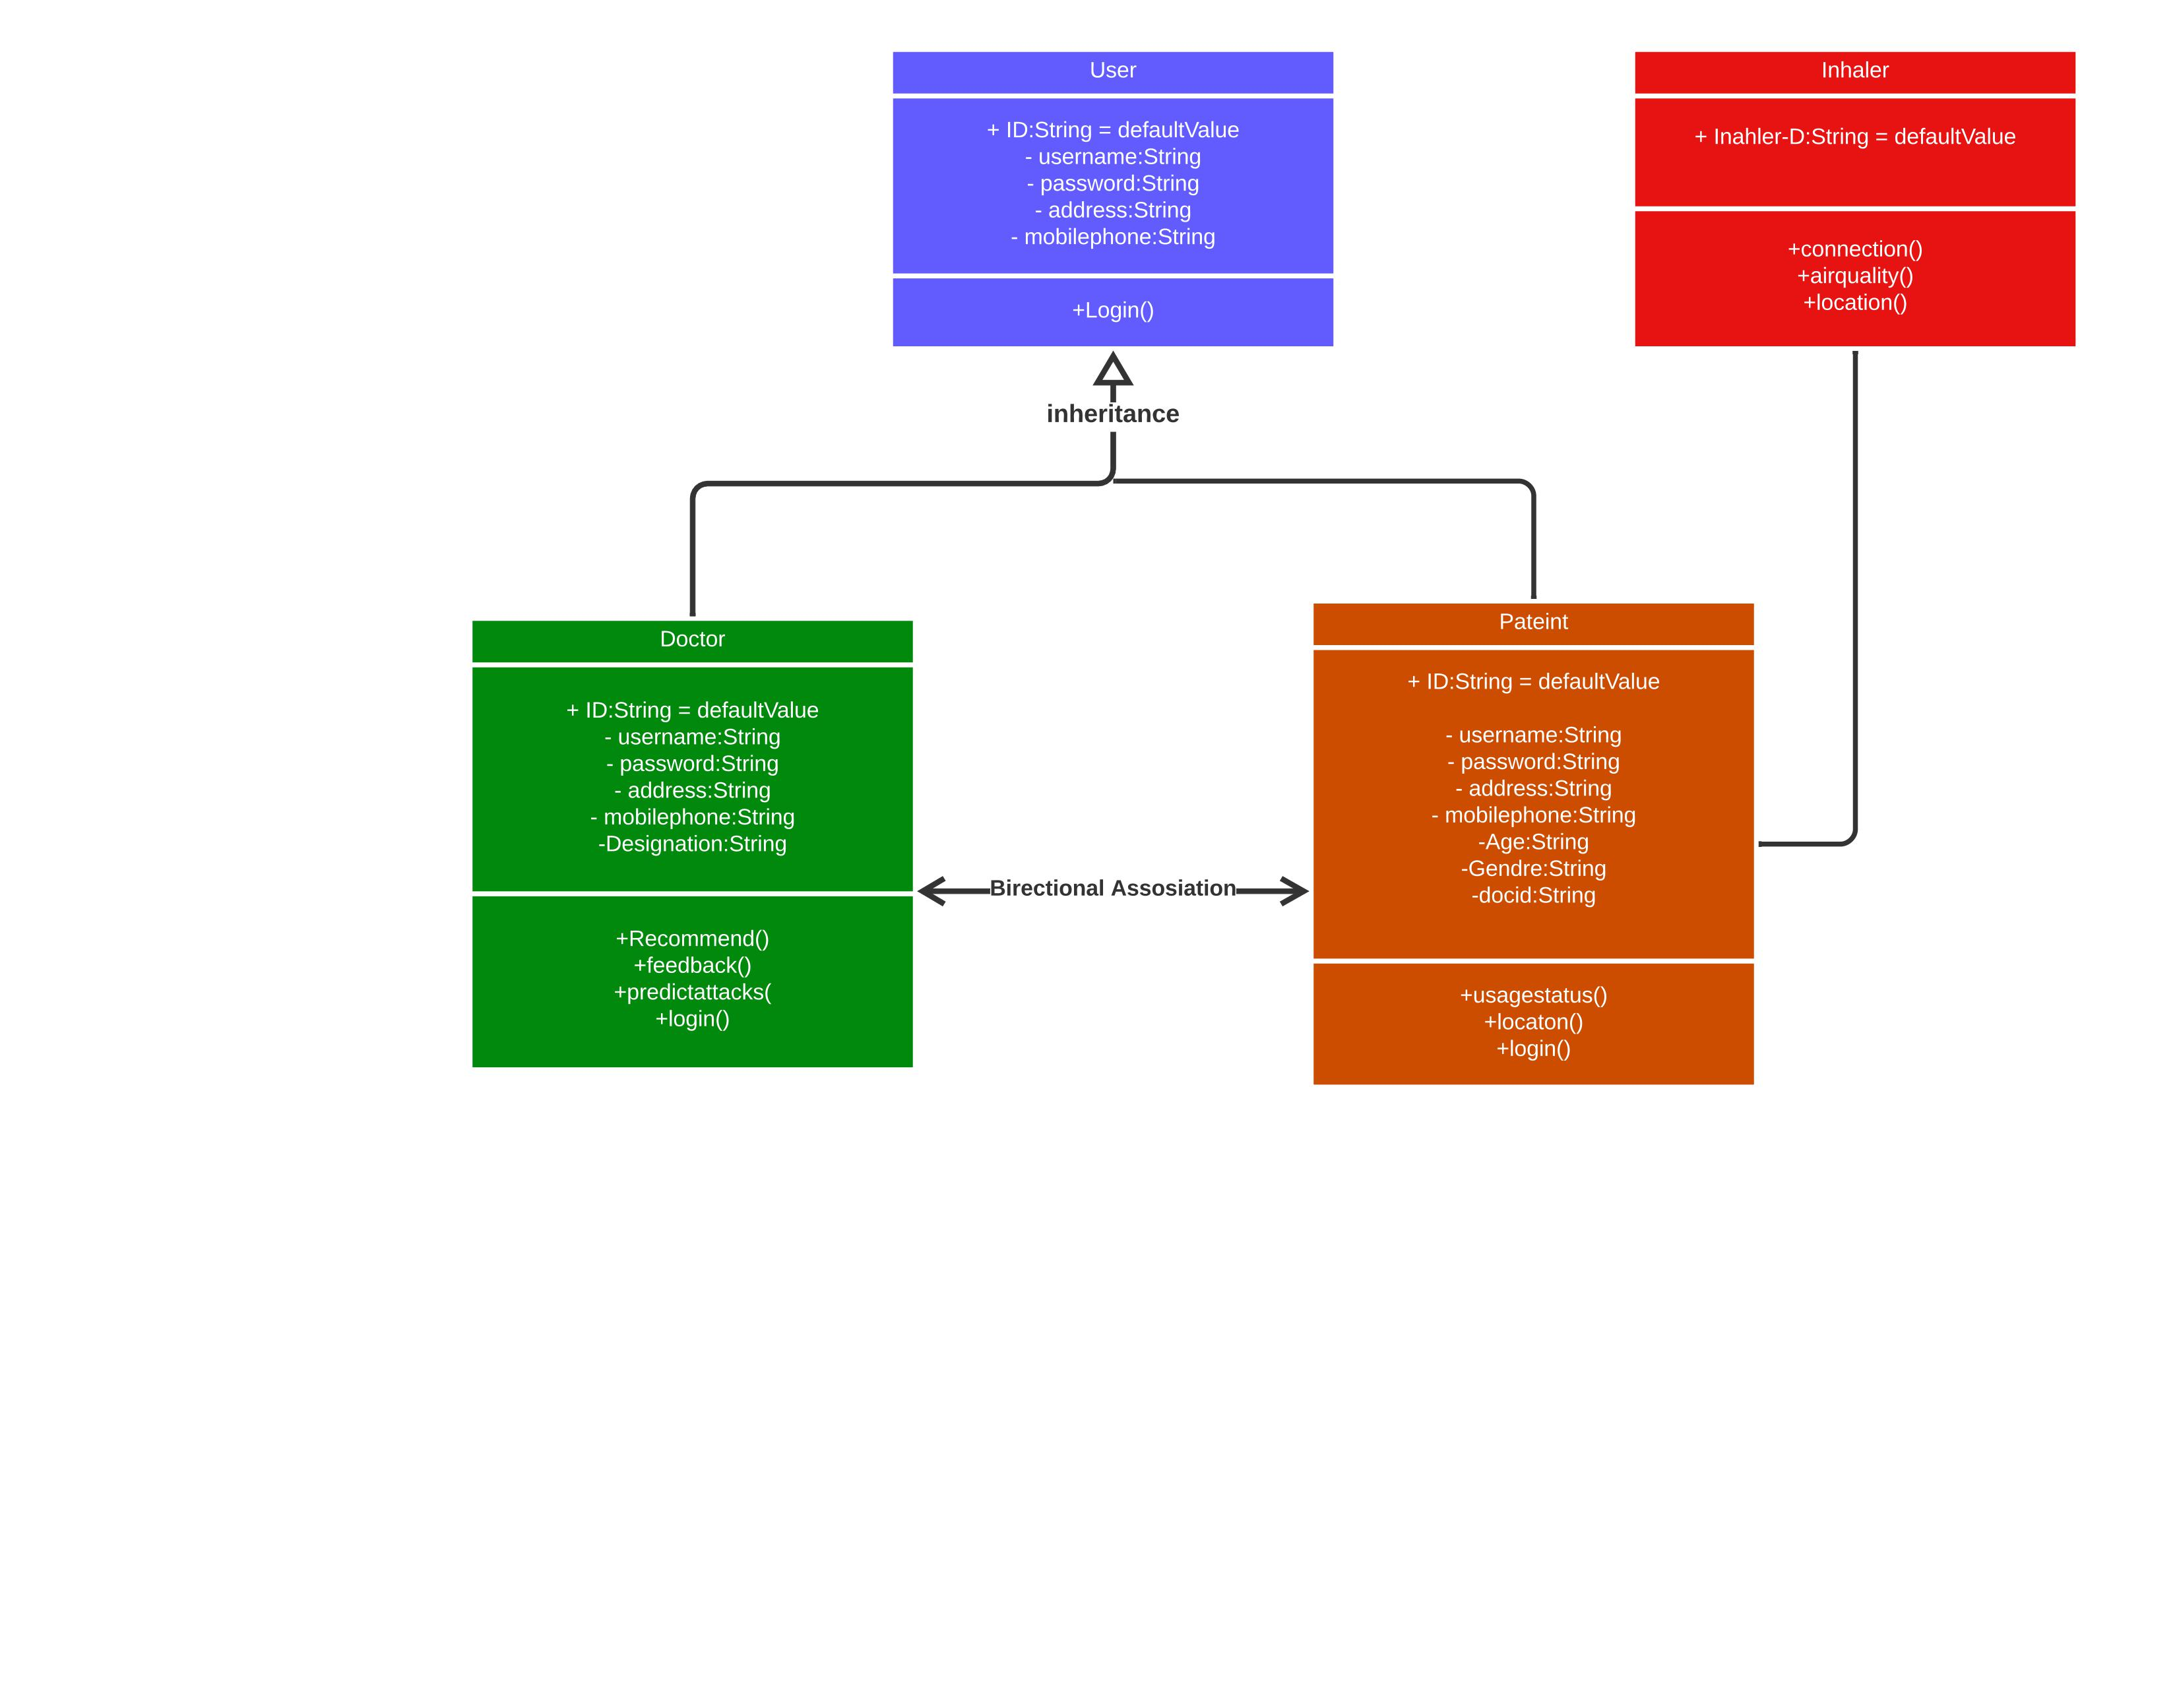
Class diagram

Slide 19
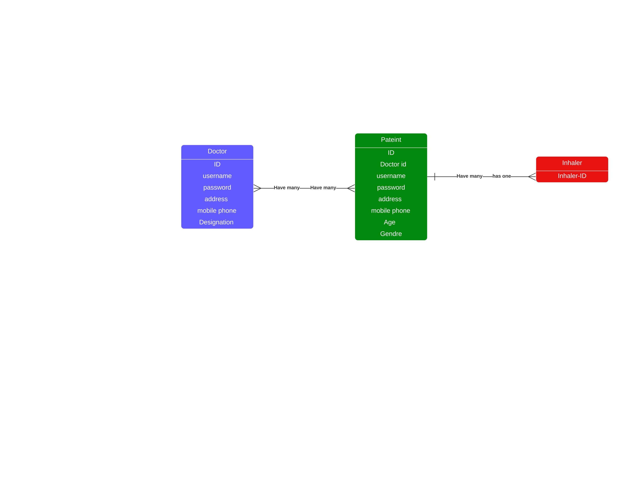
Database diagram

Slide 20


